Slide 1
Safe Stars Initiative
Tennessee Athletic Trainers Association
December 14, 2022
Terrence R. Love, Injury Prevention Director, Tennessee Department of Health

Slide 2
Safe Stars Initiative

Slide 3
What is the TDH Safe Stars Program?
Safe Stars is a collaboration between the Tennessee Department of Health and the Program for Injury Prevention in Youth Sports at The Monroe Carell Jr. Children's Hospital at Vanderbilt.
Safety recognition program for Youth Sports Leagues & Schools
Free and Voluntary to all organizations across Tennessee
Can achieve Gold, Silver, or Bronze level
Safe Stars goal is to standardize safety for young athletes

Slide 4
Recognition for Your Work to Prevent Injury
The Safe Stars initiative recognizes youth sports organizations throughout Tennessee for providing the highest level of safety for their young athletes.
Safe Stars consists of 3 levels: Gold, Silver, and Bronze, and involves implementation of policies around topics such as concussion education, weather safety and injury prevention.

Slide 5
Safe Stars Program Development
Safe Stars’ goal is to provide resources and opportunities for every youth sports organization to enhance their safety standards.
The criteria for achieving recognition as a Safe Stars league has been developed by a committee of health professionals dedicated to reducing sports-related injuries among youth.
Complies with and supports the TN Safe Stars Act of 2021

Slide 6
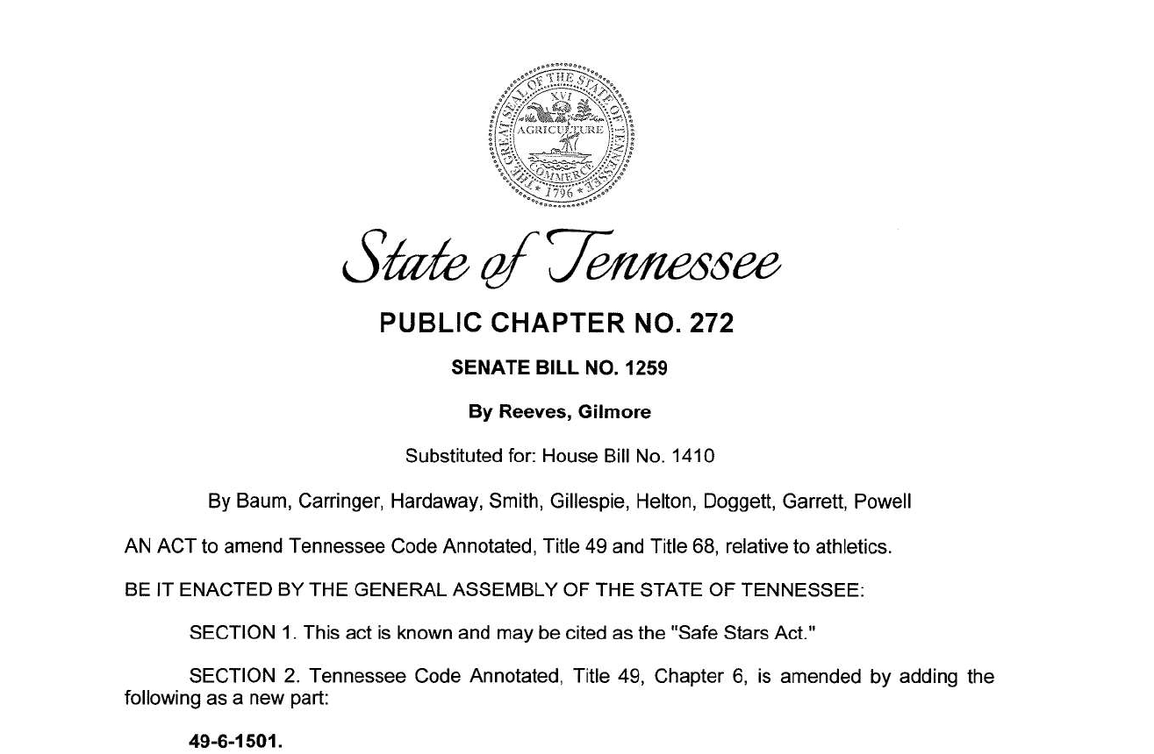
Safe Stars Act of Tennessee (Public Charter 272)

Slide 7
Safe Stars Act (Required Training)
Took effect fall 2022
All coaches shall annually complete:
Concussion course
Sudden Cardiac Arrest course
Be “TRAINED” in CPR and AED use
Complete a Background Check

Slide 8
Safe Stars Act (Required Plans and Policies)
Plans and Polices that must be implemented
Allergy and anaphylaxis EAP
Signs & symptoms
Epi pen location, storage use, and administration
Emergency follow-up procedures

Slide 9
Safe Stars Act (Required Plans and Policies)
Plans and Polices that must be implemented
Severe weather policy
Lightning policy
Heat illness & lightning education for all coaches (annually)

Slide 10
Coaches Code of Conduct (Required)
Shall develop a Coaches Code of Conduct
Encouraged to
Review TDH Safe Stars Website
Private schools
Community Leagues

Slide 11
Sudden Cardiac Arrest Symptom Warning Signs Information Sheet (Required)
Parent/Guardian Requirements
Must sign Sudden Cardiac Arrest information sheet
Must sign each year

Slide 12
Required Informational Meeting/Video
Informational Meeting or Video
Must hold before start of each athletic season
Symptoms and warning signs of Sudden Cardiac Arrest
Heat illness
Concussions
Other health issues related to sports participation
EKG information testing
EAP/Safety plans

Slide 13
Safe Stars Initiative

Slide 14
Bronze Level – Ensures Compliance with Safe Stars Act of 2022
Bronze is the initial level of recognition for the Safe Stars program. To reach the initial level of recognition, the Bronze Star standard, a league must meet the following policy requirements:
POLICY REQUIREMENTS
Emergency Action Plan (link)
Anaphylaxis and allergy emergency plan (link)
Background and fingerprinting checks completed on all coaches (link)
Severe weather policy (including heat & lightning) (link)
Completion of a Coaches Code of Conduct (link)
Safeguarding policy for preventing and reporting child abuse & neglect (link)

Slide 15
Bronze Level
Bronze is the initial level of recognition for Safe Stars. To reach the initial level of recognition, the Bronze Star standard, a league must meet the following training requirements:
TRAINING REQUIREMENTS
All coaches CPR/AED trained (project ADAM, Red Cross)
All coaches trained annually in concussion and sudden cardiac arrest recognition/management (link)
All coaches trained annually in sudden cardiac arrest recognition/management (link)
All coaches trained annually in heat illness prevention (link)
Students’ parent/guardian must sign Cardiac Arrest symptoms and warning signs information sheet (link coming soon)
Informational meeting of video before athletic season for students, parents, coaches and school officials on SCA, heat illness, concussions, EKG, and other safety information

Slide 16
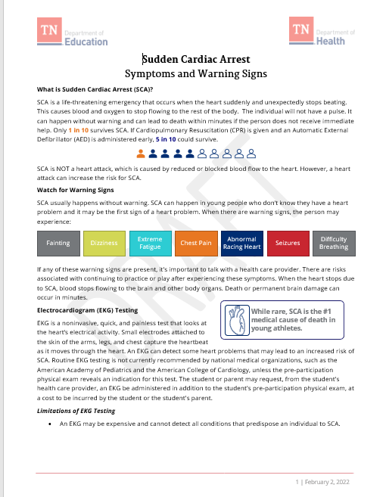
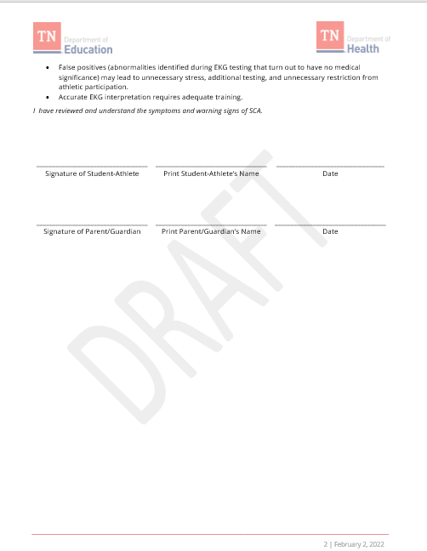
DRAFT – Sudden Cardiac Arrest Form

Slide 17
To Become SILVER
For SILVER, a league must meet all BRONZE requirements, and
AED available at all hosted practices and games
Completion of a Parents Code of Conduct (link)
Plus choose any 2 criteria from the “extra criteria” on next slide

Slide 18
To Be Recognized at the GOLD
For Gold, an organization must meet all Bronze & Silver requirements
Plus (choose any 4 extra criteria) from list below:
Pre-participation physical examination required for athletes
Risk and safety information/policies relayed to parents/guardians
All coaches complete additional health, safety and injury prevention training
All athletic equipment undergoes safety checks
Medical professional (athletic trainer, first responder, etc.) on site for all games
Medical professional (athletic trainer, first responder, etc.) on site for all practices
All coaches CPR/AED certified
Opioid abuse and misuse awareness/education
Promote positive culture and standard of expectations concerning behavior (ex. Coaching Boys Into Men or Athletes as Leaders)

Slide 19
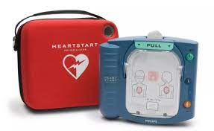
AED Vouchers are Available for Qualifying Groups
Organization must:
Complete the Safe Stars Session at the Youth Sports Injury Conference
Sign the agreement to complete a Safe Stars application
Complete the Safe Stars application and provide documentation to TDH
Complete AED Application to demonstrate need at organization site (need to cover multiple sites, meet 3-5 minutes recommendation, etc.)
AEDs will be provided if available

Slide 20
Barriers and Resources
Discuss potential barriers and solutions to application
Who can help you on your campus?
What resources do you have (TSSAA, TDH, TATs, etc.)?
Which policies or trainings will be easy to do?
What will be your biggest challenge?
Review model policies and practices
Review resources on web page to facilitate application
Discuss timelines for application completion
Commit to date for completion
Apply for AED

Slide 21
How to Apply for Safe Stars
Visit the TN Safe Stars Initiative Website
Download the printed application
Do an overview assessment of your organization’s current compliance with requirements
Emergency Action Plan
Coach training
Policy assessment
Etc.
Collect existing policies and make changes if necessary
Fill out the online application via REDCap & upload policies
TDH staff will contact you to help you complete the process
Comply with the Safe Stars Act and become recognized via TDH Safe Stars program at the BRONZE level

Slide 22
Application Process Review
Encouraged to read through application before applying
Must upload certificates and other documents in application (TDH Staff will help)
Resources are available to you on the Safe Stars website
Recognition is valid for 5 years
Current Safe Stars schools and organizations are being notified to update their policies and practices to comply with Safe Stars Act of 2022.

Slide 23
Benefits for the League/Organization
Signed certificate from the TDH Commissioner
Safe Stars logo to put on t-shirts, banners, stickers, etc..
Recognition on the TDH website
Ability to demonstrate to parents safe practices
Ability to share Safe Stars certification with stakeholders and funding agencies
Helps schools and organizations comply with the TN Safe Stars Act of 2022

Slide 24
Questions and Feedback
Terrence R. Love
Injury Prevention Director
Tennessee Department of Health
615-532-7775
Terrence.Love@tn.gov
Janay Smith
Health Educator
Tennessee Department of Health
615-532-0308
Janay.Smith@tn.gov

Slide 25
END

